Slide 1
YouBike Forecast
Ryan Huang 黃琮仁

Slide 2
Get a Glimpse of the Data
1
Data Preprocessing & Exploratory Data Analysis
Notes:
Let’s start from our data preprocessing and our EDA.

Slide 3
Data Preprocess
Rent Record
Station Summary
sta_id | rent_time | return_time
5 | 2016/1/10 13:51 | 2016/1/10 15:00
10 | 2016/1/21 16:46 | 2016/1/21 17:10
5 | 2016/1/14 15:38 | 2016/1/14 16:24
5 | 2016/1/16 16:45 | 2016/1/16 17:21
7 | 2016/1/1 08:11 | 2016/1/1 09:05
63 | 2016/1/6 17:41 | 2016/1/6 18:11
sta_id | period | demand
1 | 2016/1/1 00:00 | 0
 | ... | ...
 | 2016/1/31 23:00 | 0
2 | 2016/1/1 00:00 | 0
 | ... | ...
... | ... | ...
Notes:
For the data preprocessing,
Firstly, we tried to dive in the rent record.
We included the rent-station-id, rent time and return time.
Then,
After preprocessing,
We collect hourly demand for every hour in every station.

Slide 4
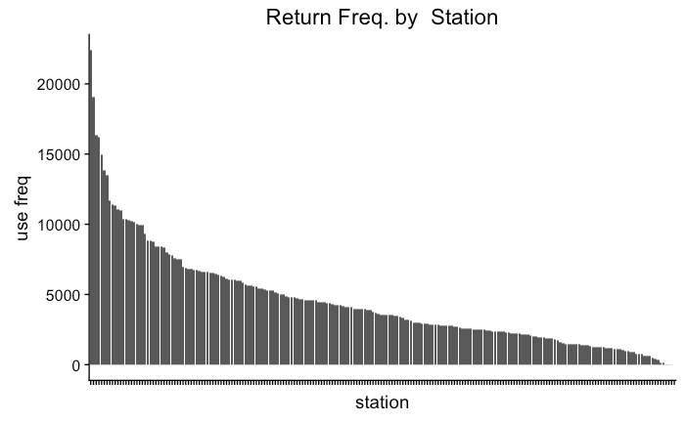
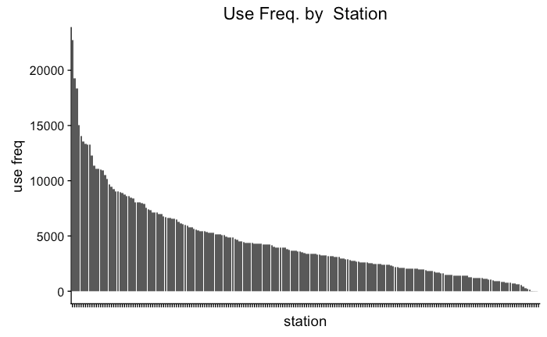
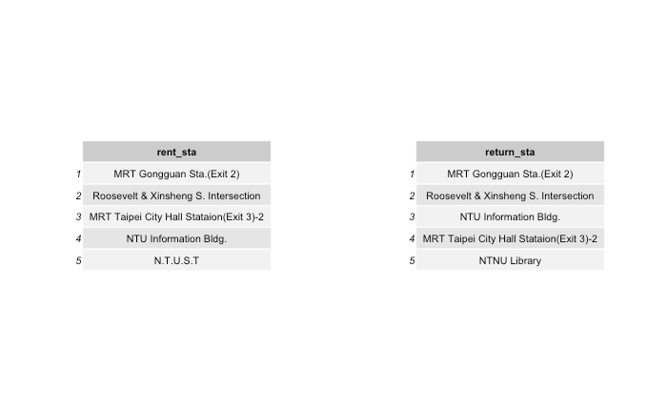
EDA
Notes:
Now, I want to explore the data to find out something behind the big data set!
As you can see, the most three frequency rent station are 公館、羅斯福新生路口、市政府

Slide 5
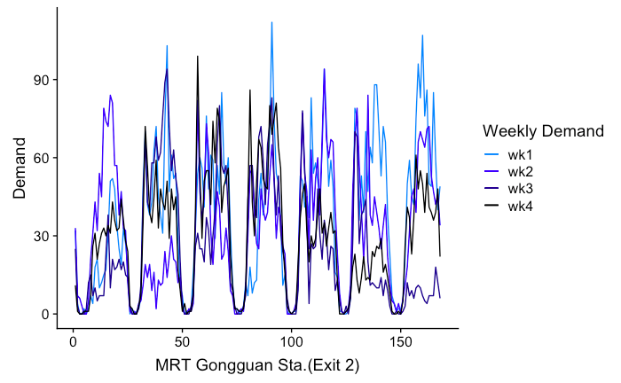
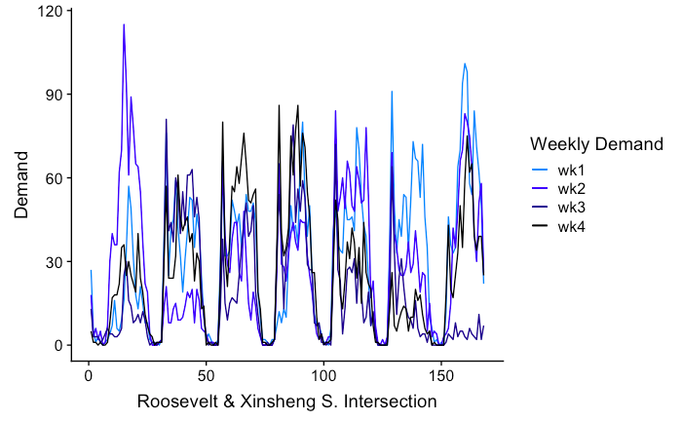
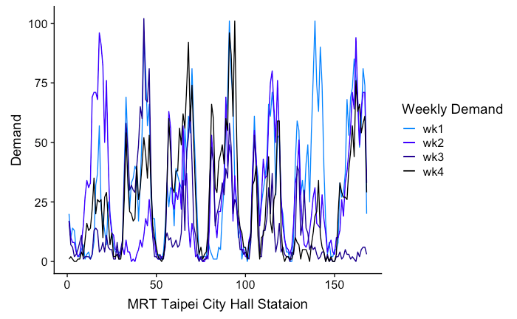
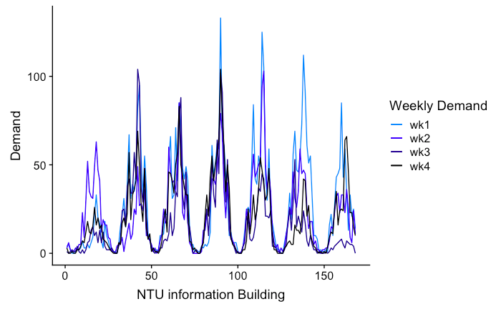
EDA rent by week
Notes:
We also plot the weekly demand pattern of the most used 4 stations,
As shown by the plots, the demand of each day on different week is similar to each other.

Slide 6
Build up our Models
2
Autoregression Model & Hidden Markov Model
Notes:
Then, we start to build our models.

Slide 7
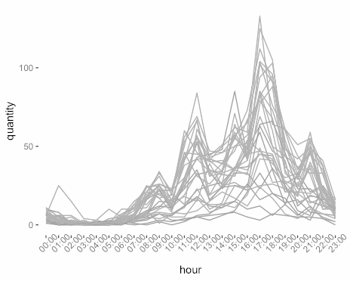
Intuitive Model (1)
Notes:
When I look at the daily demand pattern, I notice 3 things
Firstly, the everyday hourly demand is similar to each other as the plot shows a clear pattern.

Slide 8
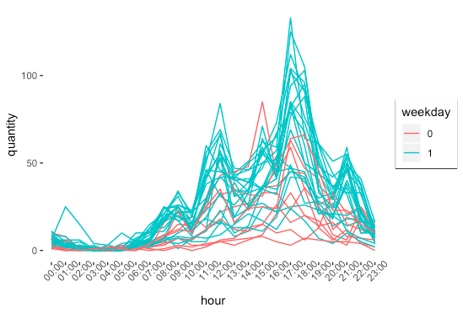
Intuitive Model (1)
Notes:
Secondly, the demand pattern of week days is different from that of weekends
as we add different colors on weekdays and weekends

Slide 9
Intuitive Model (1)
Notes:
And lastly, the demand in a day seems to have 3 states, each state follows a different distribution.

Slide 10
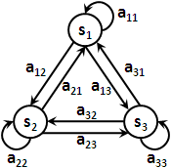
HMM Model
3 Different States
Reference: http://www.csie.ntnu.edu.tw/~u91029/about.html
Notes:
With this intuition in my mind I turn to the stan guide book for some ideas
At the part
As mentioned in the Stan guide book, a hidden markov model can well described this kind of pattern.
Hidden Markov Model, known as HMM is a 2 layer model.
We have to first decide the probability of each state and then decide the parameter of the distribution under different state.

Slide 11
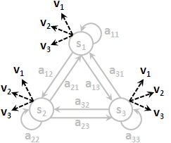
HMM Model
Demand(i) ~ Poisson( 𝜆(i) )
𝜆 = 𝛼 + 𝛽 × weekday
𝛼 ~lognormal(3, 1)
𝛽 ~ lognormal(1, 1)
3 Different States
Reference: http://www.csie.ntnu.edu.tw/~u91029/about.html
Notes:
In this case, I believe that there are 3 states in a day and each state follows a different poisson distribution.
Each of the 3 poisson distribution has its own parameter lambda, and lambda is also influenced by the categorical variable - weekday or not
So I embed a linear function alpha + beta * weekday or not to include the weekday effect

Slide 12
HMM Model
Period | State | λ | Pred
2016/1/1 00:00 |  | 1 | 0
... | ... | ... | ...
2016/1/3 10:00 |  | 30 | 32
... | ... | ... | ...
Demand(i) ~ Poisson( 𝜆(i) )
𝜆 = 𝛼 + 𝛽 × weekday
𝛼 ~lognormal(3, 1)
𝛽 ~ lognormal(1, 1)
3 Different States
Expected Outcome
Reference: http://www.csie.ntnu.edu.tw/~u91029/about.html
Notes:
With HMM model and the corresponding Viterbi algorithm,
we are able to figure out the most probable state of each hour in different day
and the alpha, beta, lambda parameters of the 3 poisson distribution.

Slide 13
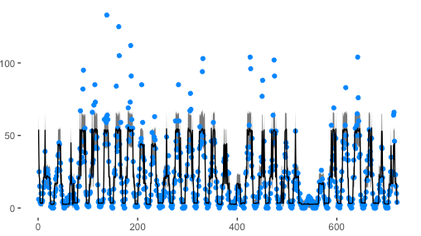
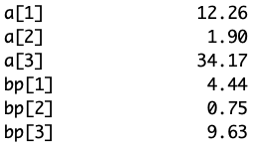
Backtest
Parameters
Notes:
Before making any prediction, I perform a backtest to make sure the HMM model is suitable for this dataset.
From this plot, we can tell that HMM model can capture most of the demand pattern.
Also, the parameters of the 3 different poisson distributions are significantly different.
Both of these results proof the adequacy of using a HMM model.
So my assumption, there are 3 different states in a day, is reasonable.

Slide 14
Train/Test Split(1)
 |  | week1 | week2 | week3
Mon. | 00:00
 | ... | ... | ... | ...
 | 08::00
 | ... | ... | ... | ...
Tue. | 00:00
week4
Poisson( 𝜆1 )
𝜆1 = 𝛼1 + 𝛽1 × weekday
MODE
Poisson( 𝜆2 )
𝜆2 = 𝛼2 + 𝛽2 × weekday
Poisson( 𝜆3 )
𝜆3 = 𝛼3 + 𝛽3 × weekday
Notes:
Then, I start to make prediction using the model.
I used the first 3 weeks data as our training dataset and leave the last week as the testing part.
To make the predictions, We first predict the state of a certain time,
then draw one random sample from the corresponding poisson distribution.
My assumption is that “the state of a certain time in the future will be similar to the same time of previous weeks”
My first attempt is to take the mode of the states of previous 3 weeks as the predicted state of week 4.

Slide 15
Train/Test Split(1)
 |  | week1 | week2 | week3
Mon. | 00:00
 | ... | ... | ... | ...
 | 08::00
 | ... | ... | ... | ...
Tue. | 00:00
week4
Poisson( 𝜆1 )
𝜆1 = 𝛼1 + 𝛽1 × weekday
MODE
Poisson( 𝜆2 )
𝜆2 = 𝛼2 + 𝛽2 × weekday
Poisson( 𝜆3 )
𝜆3 = 𝛼3 + 𝛽3 × weekday
Notes:
As you can see from the illustration, at the midnight of Monday,
There are 2 different states. So I take the mode and predict the state of the same time for week 4.

Slide 16
Train/Test Split(2)
 |  | week1 | week2 | week3
Mon. | 00:00
 | ... | ... | ... | ...
 | 08::00
 | ... | ... | ... | ...
Tue. | 00:00
week4
⅔ * Poisson( 𝜆1 )
⅓ * Poisson( 𝜆2 )
Average
⅔ * Poisson( 𝜆3 )
⅓ * Poisson( 𝜆1 )
⅔ * Poisson( 𝜆2 )
⅓ * Poisson( 𝜆1 )
Notes:
Later, I realize that the state of each time is not as valuable as the actual quantities we predict.
And I also recall the concept of ensembling.
So my second attempt is to average over the previous 3 weeks to include all the information from the training dataset
Instead of using only one poisson distribution, I draw 3 samples from each of the 3 weeks and take the average quantities\
as my predicted demand quantities for the time

Slide 17
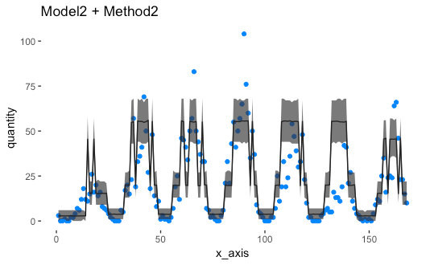
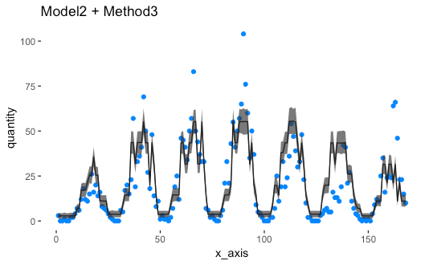
Comparison
Mode Prediction
RMSE = 14.96
Average Prediction
RMSE = 11.81
Notes:
Here is the comparison of the 2 prediction methods by plotting the predicted demand against the actual demand in test data,
And we also calculate the RMSE as the KPI.
So which method is better?
Though the computation of the mode prediction is simpler than the average prediction,
the RMSE score and the plots both show that average prediction performs better\
With narrower CI and smaller RMSE
So we will choose HMM with average prediction in our future application.

Slide 18
Thanks!

Slide 19
Credits
Special thanks to all the people who made and released these awesome resources for free:
Presentation template by SlidesCarnival
Photographs by Unsplash

Slide 20
Presentation design
This presentation uses the following typographies:
Titles: Raleway ExtraBold
Body copy: Raleway Light
You can download the fonts at https://www.fontsquirrel.com/fonts/raleway
You don’t need to keep this slide in your presentation. It’s only here to serve you as a design guide if you need to create new slides or download the fonts to edit the presentation in PowerPoint®

